Slide 1

Hedgehog Rock

Slide 2
University of Science and Technology Bannu
Data Mining
Lesson 10
February 29, 2024

Slide 3
Learning Objectives
Multi layer Feed Forward Network
Back Propagation
Classification by backpropagation

Slide 4
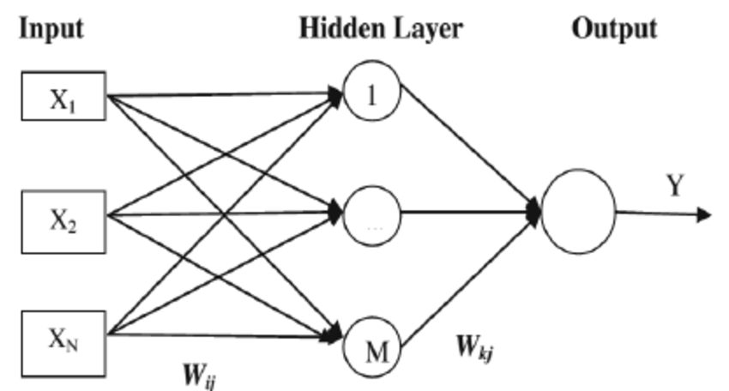
Multilayer feed-forward Neural Network
A multilayer feed-forward neural network consists of an input layer, one or more hidden layers, and an output layer.
An example of a multilayer feed-forward network is shown in Figure

Slide 5
Multilayer feed-forward Neural Network
Each layer is made up of units.
The inputs to the network correspond to the attributes measured for each training tuple.
The inputs are fed simultaneously into the units making up the input layer.
These inputs pass through the input layer and are then weighted and fed simultaneously to a second layer of “neuronlike” units, known as a hidden layer.
The outputs of the hidden layer units can be input to another hidden layer, and so on.
The number of hidden layers is arbitrary, although in practice, usually only one is used.
The weighted outputs of the last hidden layer are input to units making up the output layer, which emits the network’s prediction for given tuples.

Slide 7
Defining a Network Topology
How can I design the neural network’s topology?
Before training can begin, the user must decide on the network topology by specifying the number of units in the input layer, the number of hidden layers (if more than one), the number of units in each hidden layer, and the number of units in the output layer.
Normalization: Normalizing the input values for each attribute measured in the training tuples will help speed up the learning phase.
Typically, input values are normalized so as to fall between 0.0 and 1.0.

Slide 8
Defining a Network Topology
For Binary classification, one output unit may be used to represent two classes (where the value 1 represents one class, and the value 0 represents the other).
If there are more than two classes, then one output unit per class is used.

Slide 9
Defining a Network Topology
There are no clear rules as to the “best” number of hidden layer units.
Network design is a trial-and-error process and may affect the accuracy of the resulting trained network.
The initial values of the weights may also affect the resulting accuracy.
Once a network has been trained and its accuracy is not considered acceptable, it is common to repeat the training process with a different network topology or a different set of initial weights

Slide 12
Backpropagation
“How does backpropagation work?”
Backpropagation learns by iteratively processing a data set of training tuples, comparing the network’s prediction for each tuple with the actual known target value.
The target value may be the known class label of the training tuple (for classification problems) or a continuous value (for numeric prediction).

Slide 13
Backpropagation
For each training tuple, the weights are modified so as to minimize the mean-squared error between the network’s prediction and the actual target value.
These modifications are made in the “backwards” direction (i.e., from the output layer) through each hidden layer down to the first hidden layer (hence the name backpropagation).
Although it is not guaranteed, in general the weights will eventually converge, and the learning process stops.

Slide 14
Backpropagation
1. Initialize the weights:
The weights in the network are initialized to small random numbers (e.g., ranging from −1.0 to 1.0, or −0.5 to 0.5).
Each unit has a bias associated with it.
The biases are similarly initialized to small random numbers.
Each training tuple, X, is processed by the following steps

Slide 15
Backpropagation
2. Propagate the inputs forward:
First, the training tuple is fed to the network’s input layer.
The inputs pass through the input units, unchanged.
That is, for an input unit, j, its output, Oj , is equal to its input value, Ij .
Next, the net input and output of each unit in the hidden and output layers are computed.

Slide 16
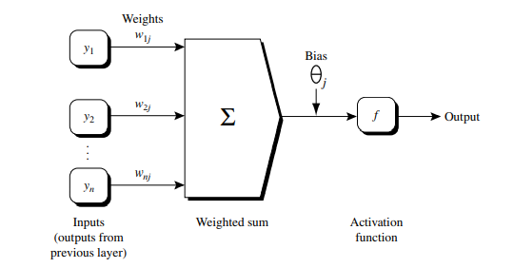
Backpropagation
The net input to a unit in the hidden or output layers is computed as a linear combination of its inputs.

Slide 17
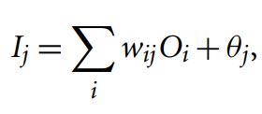
Backpropagation
Given a unit, j in a hidden or output layer, the net input, Ij , to unit j is represented by the below formula
where wij is the weight of the connection from unit i in the previous layer to unit j; Oi is the output of unit i from the previous layer; and θj is the bias of the unit.

Slide 18
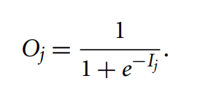
Backpropagation
Each unit in the hidden and output layers takes its net input and then applies an activation function to it.
The logistic, or sigmoid, function is used. Given the net input Ij to unit j, then Oj , the output of unit j, is computed as
We compute the output values, Oj , for each hidden layer, up to and including the output layer, which gives the network’s prediction.

Slide 19
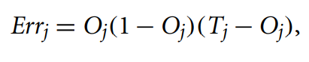
Backpropagation
Backpropagate the error:
The error is propagated backward by updating the weights and biases to reflect the error of the network’s prediction. For a unit j in the output layer, the error Errj is computed by:
where Oj is the actual output of unit j, and Tj is the known target value of the given training tuple.

Slide 20
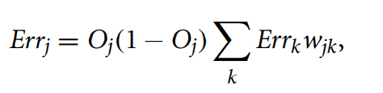
Backpropagation
To compute the error of a hidden layer unit j, the weighted sum of the errors of the units connected to unit j in the next layer are considered. The error of a hidden layer unit j is
where wjk is the weight of the connection from unit j to a unit k in the next higher layer, and Errk is the error of unit k.

Slide 21
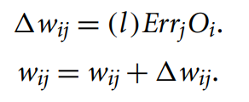
Backpropagation
The weights and biases are updated to reflect the propagated errors. Weights are updated by the following equations, where wij is the change in weight wij:
The variable “l” is the learning rate, a constant typically having a value between 0.0 and 1.0.

Slide 22
Backpropagation
Terminating condition:
Training stops when
All wij in the previous epoch are so small as to be below some specified threshold, or
The percentage of tuples misclassified in the previous epoch is below some threshold, or
A prespecified number of epochs has expired.

Slide 23
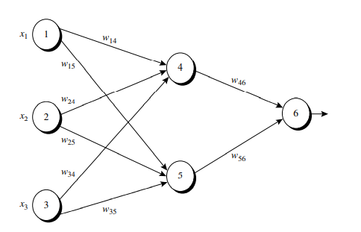
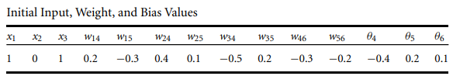
Example
Figure shows a multilayer feed-forward neural network. Let the learning rate be 0.9. The initial weight and bias values of the network are given in Table , along with the first training tuple, X = (1, 0, 1), with a class label of 1.

Slide 24
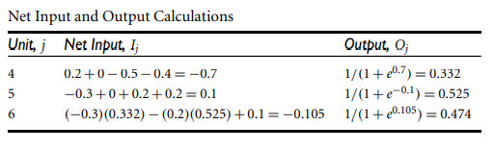

Slide 25
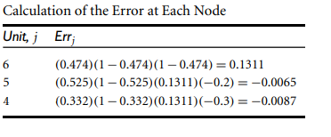
Error Calculation

Slide 26
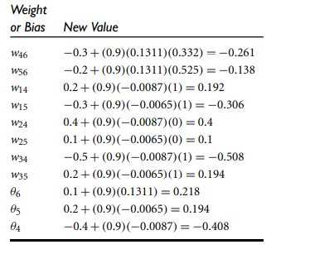
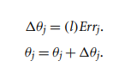
Calculations for Weight and Bias Updating

